Slide 1
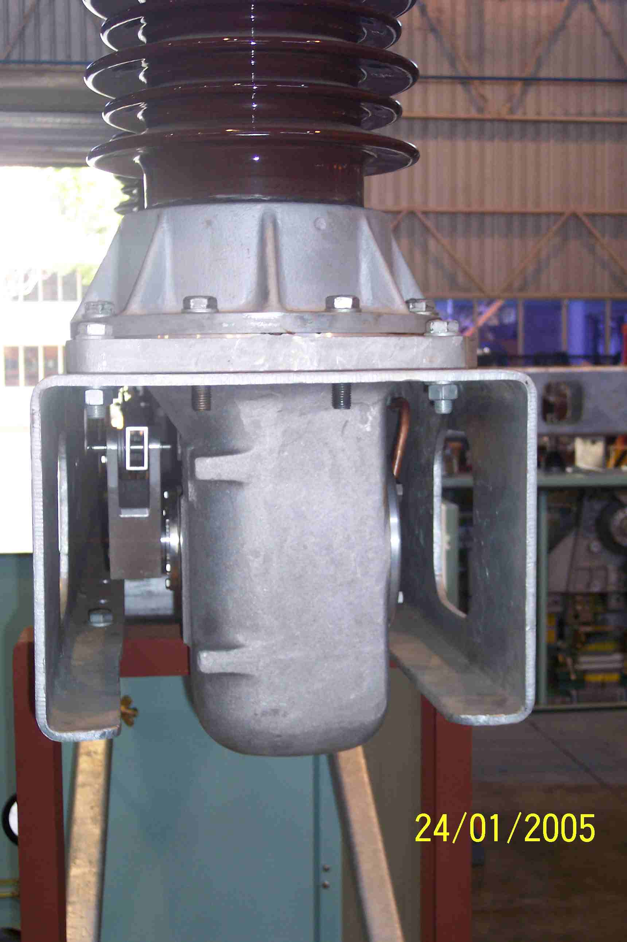
SIEMENS
HVCB SPARES
Gear Box Housing
72.5KV, 40KA ,145KV CB
S4804877001

